Slide 1




COVID - 19
DETAILED CASE STUDY
&
DATA ANALYSIS

Slide 2
MEMBERS
01
GURSHAAN SINGH BHASIN
02
Mohamed Shoukat Ali
03
HARSHITA SAHU

Slide 3
CONTENT
01
02
03
MOTIVATION
INTRODUCTION
DATA ANALYSIS
04
05
06
CASE STUDY
INFERENCES
CONCLUSION
07
BIBLIOGRAPHY

Slide 4


1.INTRODUCTION
COVID-19, also known as the novel coronavirus, is a highly contagious respiratory illness caused by the SARS-CoV-2 virus. It emerged in Wuhan, China, in late 2019 and quickly spread worldwide, leading to a global pandemic. The virus primarily spreads through respiratory droplets when an infected person coughs, sneezes, or talks, but it can also be transmitted by touching contaminated surfaces.
The symptoms of COVID-19 range from mild to severe and include fever, cough, fatigue, loss of taste or smell, and difficulty breathing. While many people experience mild symptoms or remain asymptomatic, the virus can cause severe respiratory distress and other complications, particularly in older adults and individuals with underlying health conditions. Efforts to control the spread of the virus have included widespread testing, contact tracing, mask-wearing, social distancing, and vaccination campaigns.
The COVID-19 pandemic has had far-reaching effects on societies and economies worldwide. Governments have implemented various measures such as lockdowns, travel restrictions, and the closure of businesses and schools to contain the virus's spread. The pandemic has disrupted global supply chains, led to job losses, and strained healthcare systems. Efforts to combat the virus have included the development and distribution of vaccines, which have played a crucial role in reducing severe illness and death rates. However, the ongoing emergence of new variants highlights the need for continued vigilance and adherence to public health measures to control the spread of COVID-19.

Slide 5


2. MOTIVATION
COVID - 19 came out of the blue and shook not just a neighbourhood or community up , rather the entire Globe. It was an extremely large crisis with a pandemic on our hands and this project aims to perform a case study of just that.
By taking into account various countries the daily cases recorded , daily tests for COVID and the number of deaths caused -> we have showed our inference through analysis of all this data via different Data Analytics techniques some of which include - Data cleaning , Data Imputation , Visual Representation of Data and a detailed case study which aims to compare different aspects of our inferences from the data set we have considered and make factual statements to define them.
In the upcoming slides we will show a detailed representation of all the processes mentioned above along our inferences with the help of the RStudio software which allows us to work on such an immense and thorough data set and aptly visualize the functions we aim to perform and add novelty to our case study.

Slide 6
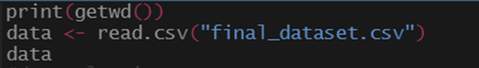
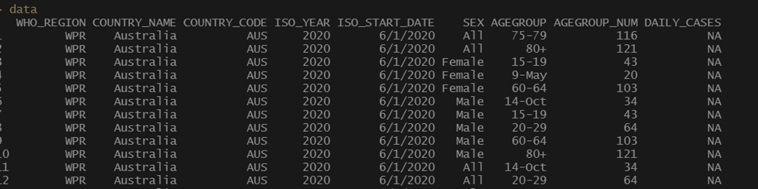
3. DATA ANALYSIS
3.1 DATA IMPLEMENTATION
This allows us to implement the csv file which stores all our required data

Slide 7
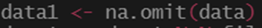
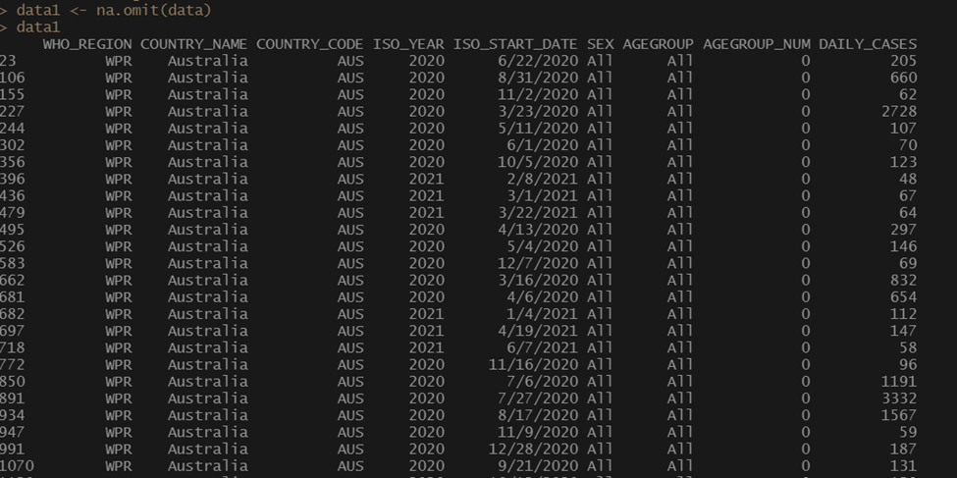
3.2 DATA IMPUTATION
This allows us to omit all those NA values which may cause errors while analyzing data later on

Slide 8
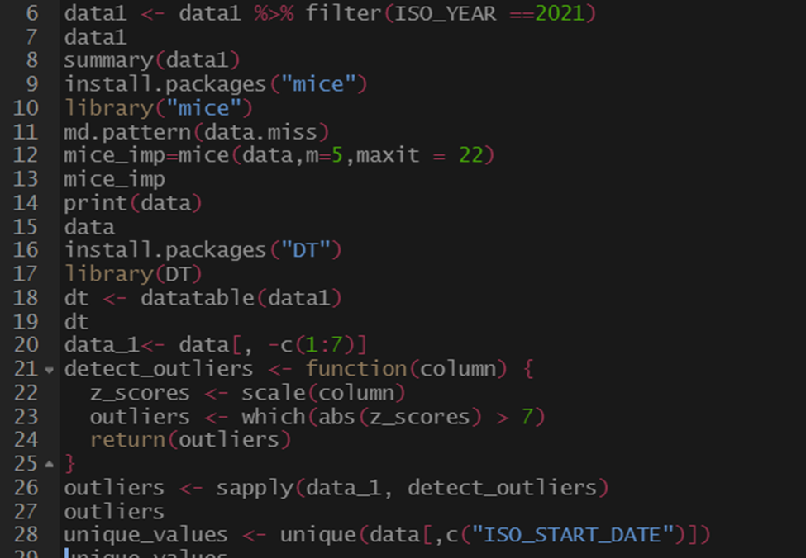
3.3.1 DATA CLEANING
The given code above is used in the data cleaning process to clean the unwanted/noisy dataset and make it into useful and info rich one
The function used above is used to get the datas from the dataset on the year 2021 and omit the other unwanted entries
The mice is a library in rstudio that is used to data imputations

Slide 9
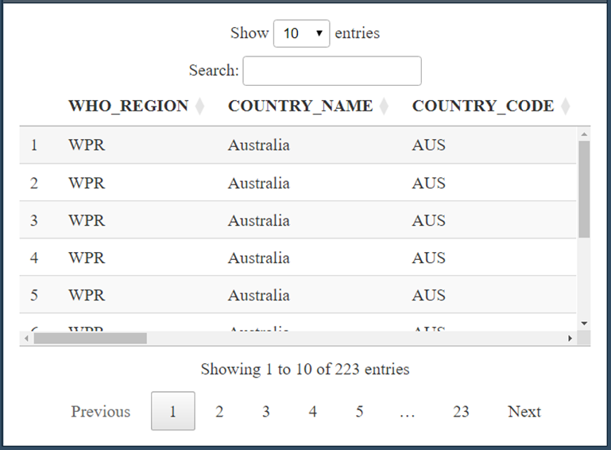
3.3.2 dt library and sapply
The dt library allows us to view any size dataset without the console omitting it
The sapply given here is used to outliers using the z score method (standard deviation comparing )

Slide 10
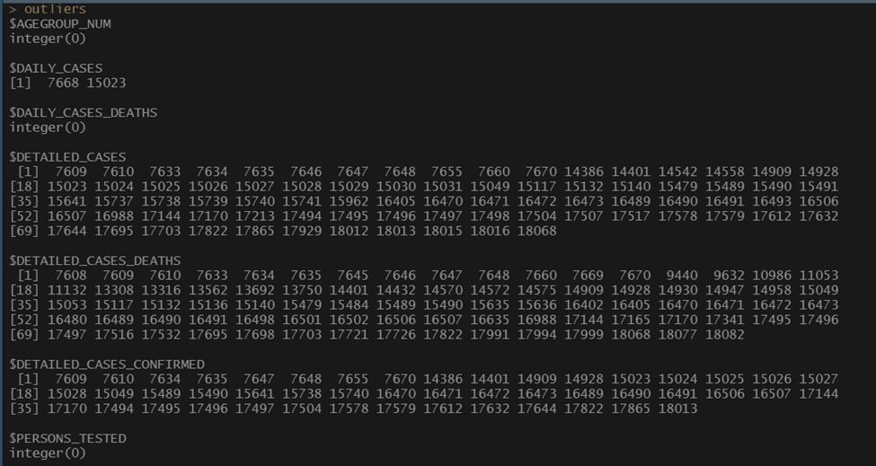
3.3.3 Unique Function

Slide 11
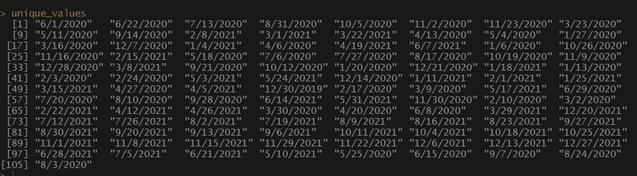
3.3.3 contd.
Unique function finds the unique values in the given column to prevent replication of the dates

Slide 12
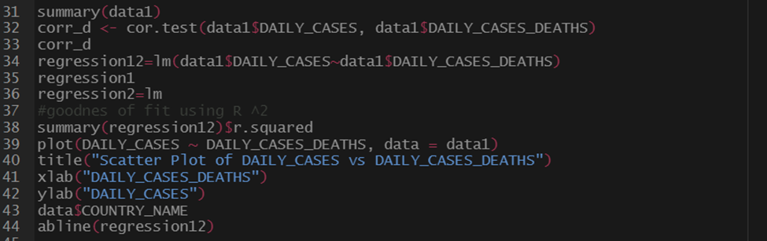
3.4 STATISTICAL ANALYSIS
3.4.1 SCATTER PLOT AND REGRESSION
The plot function here uses the scatter plot and the abline to get the regression line graph where we use x as daily cases and daily cases death

Slide 13
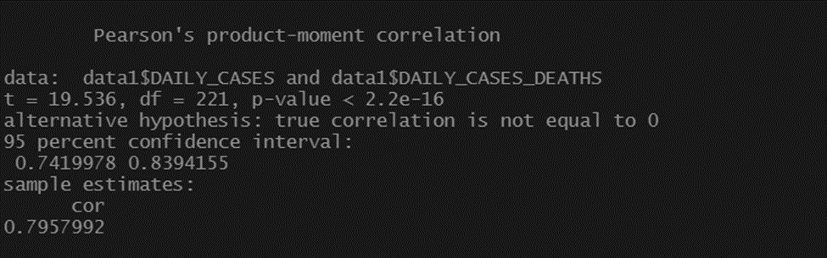
3.4.2 CORRELATION & REGRESSION CALC.
Here we find correlation and regression

Slide 14
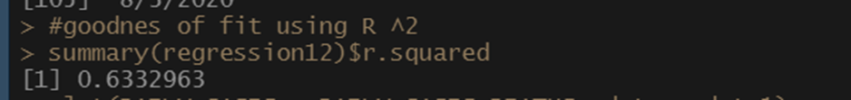
3.4.3 GOODNESS OF FIT
The regression we use here shows how the columns depend on each other (independent and dependent)
We also find the goodness of fit to ensure that there is no errors in the correlation and regression
Lm function is used to find regression cor.test is used to find correlation

Slide 15
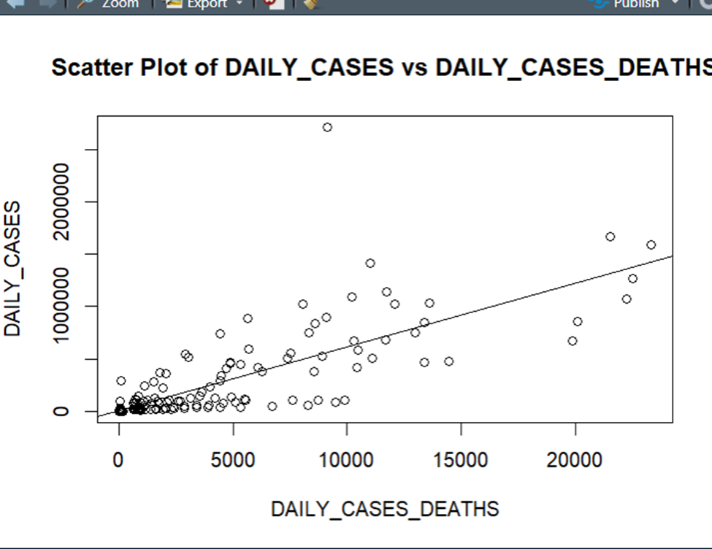
4. CASE STUDY
4.1.1 SCATTER PLOT
The data points in a regression analysis are close to the regression line which indicates a strong linear relationship between the dependent variable (Y) and the independent variable (X).
We get a line of best fit for better analysis using the abline function as mentioned earlier.

Slide 16
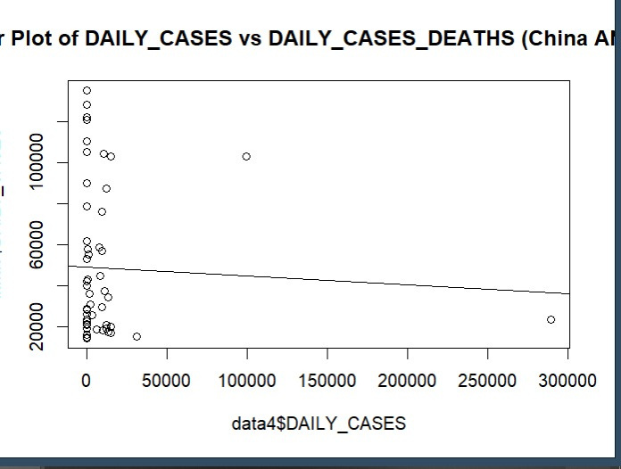
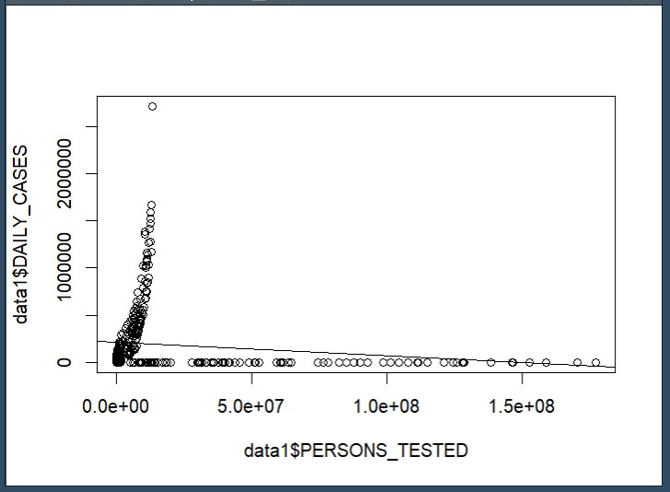
4.2.2
From these graphs we can further see clearly the relation between daily cases and daily no. of deaths of China and India which we see at a peak initially but over time how it was reduced , showing a propmt and apt response to curve the growing pandemic by the two superpowers

Slide 17
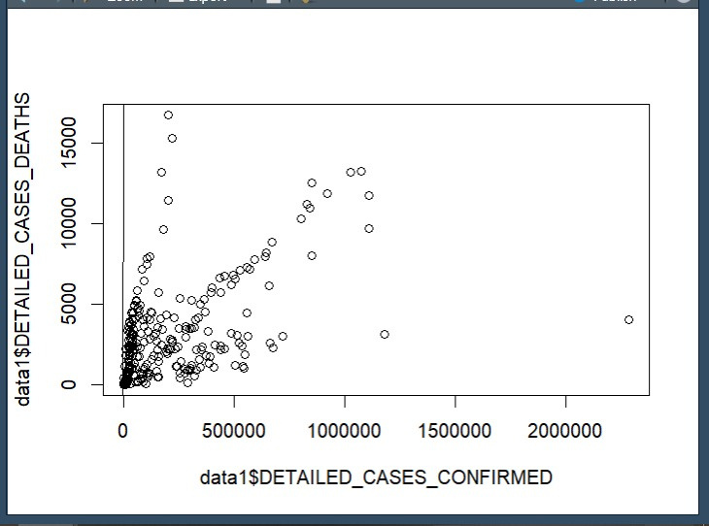
4.2.3
These graphs allow us to compare the no. of people tested to the actual no. of recorded cases , again showing great progress over time
The other graph shows the rather disappointing reality of how the no. of deaths are directly proportional to the confirmed cases , insinuating that during the early stages how response was lacking and to visualize the devastating effects of COVID-19 early on

Slide 18
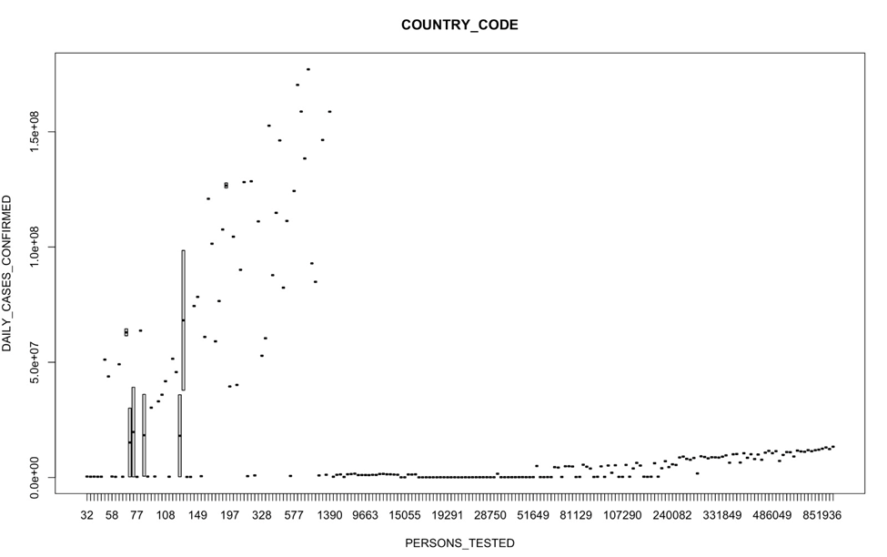
4.2 BOX PLOT
boxplot(PERSONS_TESTED ~ DETAILED_CASES_CONFIRMED, data = data,
main = "COUNTRY_CODE",
xlab = "PERSONS_TESTED",
ylab = "DAILY_CASES_CONFIRMED")
The function boxplot is used to find outliers as we can see the dots that are far from others it is how we understand that outliers are present we can also use z score as shown above which uses the standard deviations.
It is a statistical measure that indicates how many standard deviations an individual data point is away from the mean of a distribution.

Slide 19
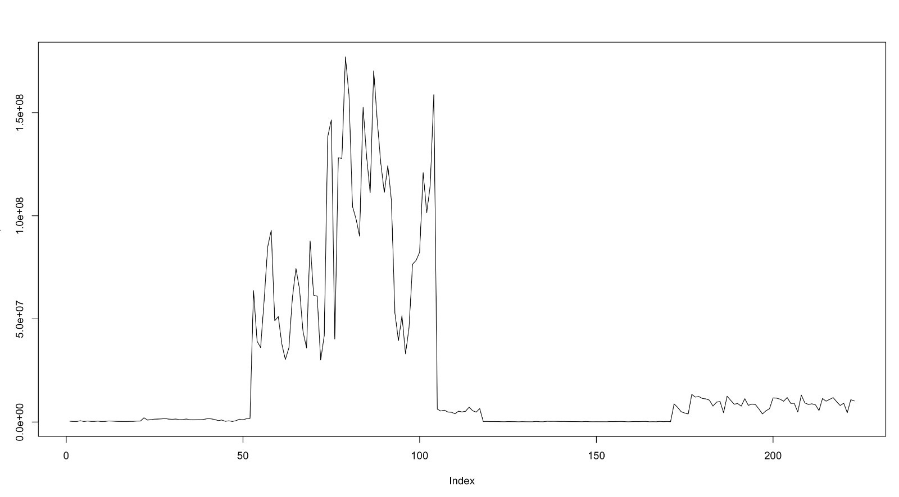
4.3 HISTOGRAM

Slide 20
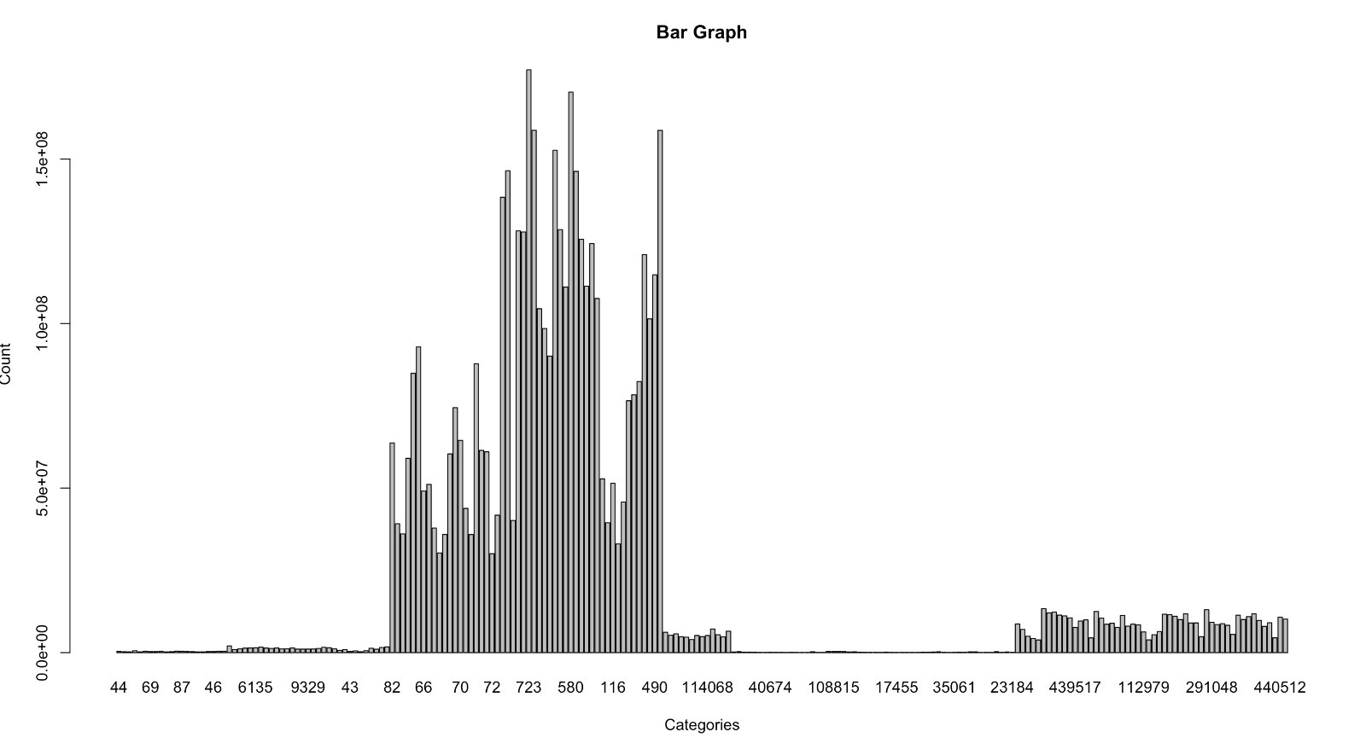
4.4 BAR GRAPH

Slide 21
5. INFERENCES
From the various graphs , we can come to understand different aspects of our data. The scattered data's plot allows us to find the line of regression which allows us to calculate a direct linear relation between the variables taken into consideration.
By imputing & cleaning the data we achieved a more efficent dataset which allowed us to then further perform more concrete analysis
By utilizing the correlation function in R Studio , we were able to find the correlation value of 0.7957 ; which by the properties of Correlation , since is close to 1 -> Indicates a strong linear relationship between the two variables that we considered , i.e Daily Cases and Daily Deaths. This Statistical proof allows us to numerically infer which countries were lagging behind in the fight against covid and further required more help , be it monetary , workforce , etc. all of which clearly showed that a lot more work was ahead of them and the losses incurred by them were extremely shocking

Slide 22
5. CONTD.
1. Strength of the relationship: The correlation coefficient ranges from -1 to +1. A correlation of 0.7957992, close to +1, suggests a strong positive relationship between the variables. As one variable increases, the other tends to increase as well.
2. Direction of the relationship: Since the correlation coefficient is positive, it indicates a positive linear relationship. This means that as the values of variable x increase, the values of variable y also tend to increase.
3. Proximity to perfect correlation: A correlation of 0.7957992 suggests that the relationship is strong, but not a perfect linear relationship (which would be indicated by a correlation coefficient of 1 or -1). There may still be some variability or scatter around the general trend.
4. Degree of linearity: The correlation coefficient measures the strength and direction of the linear relationship. A value of 0.7957992 indicates that the relationship can be reasonably approximated by a straight line, but it does not imply causation between the variables.

Slide 23
6. CONCLUSION
Hence , we were able to extract a raw dataset , implement it , clean it , impute it -> then we performed statistical analysis' on it and finally visualized these inferences for us to better comprehend the data and plan future actions accordingly.
With these calculations , it could've been easier to plan on a much larger scale for organizations such as most notably the WHO , under the UN's mandate to urge countries to send relief measures to the countries afflicted deeply and for the countries themselves to analyse the state of their people and thus plan quarantines & isolations , vaccine spreads to different regions and the respective measures of aid based on the statistical analysis of cases to deaths with the click of a few buttons and a simple code as implemented by us.
This goes to prove the importance of Data Analytics and the importance of understanding the real time application of such softwares with their vast array of functions to work on data efficiently and allow us as users to come to well thought and calculated decisions which would in this case not necessarily save money , but save lives on the grandest scale of them all.
The World itself

Slide 24
7. BIBLIOGRAPHY
WORLD HEALTH ORGANIZATION (WHO) OFFICIAL DATA
https://covid19.who.int/
https://www.analyticsvidhya.com/blog/2022/03/an-analysis-on-covid-19-in-india/
https://www.sciencedirect.com/science/article/pii/S2452014422000139
The guidance of our teacher , Prof. Kiruthika V.

Slide 25




Thank
you!

